Slide 1
Pandas
Presentations
Michael McBride, Bretton Maybee, Gunjan Batth, Cindy Ngo, Lorena Arse

Slide 2
Agenda
Research Question
Methodology & Data Sources
Findings & Analysis
Conclusions

Slide 3
Research Question
COVID-19 Paradox: Has COVID-19 had a significant impact on Mortality Rates compared to years prior? How has COVID-19 affected different areas in the United States?
Notes:
Flash Different articles questioning if mortality rates are higher in 2020 due to COVID-19

Slide 4
Methodology & Sources
Methodology
Pre-COVID Mortality Rates
2020 Mortality Rates
COVID-19 affects in different areas
Source: Aggregated Mortality data from 1999-2018 from the CDC Wonder.
Obtained Overall death rate (Total Deaths/Total Population
Broken up by State, Age & Race
Source: CDC COVID Deaths in the US.
Total Death rate in 2020 (Including Covid deaths)
Broken down by State, Age & Race
Sources: CDC Excess Deaths Associated by COVID. NY TImes COVID-19 Data
Which areas in the US were affected heavily.

Slide 5
Data Sources & Analysis
Data Sources, what it looks like and code demo along with analysis.
Notes:
Flash Different articles questioning if mortality rates are higher in 2020 due to COVID-19

Slide 6
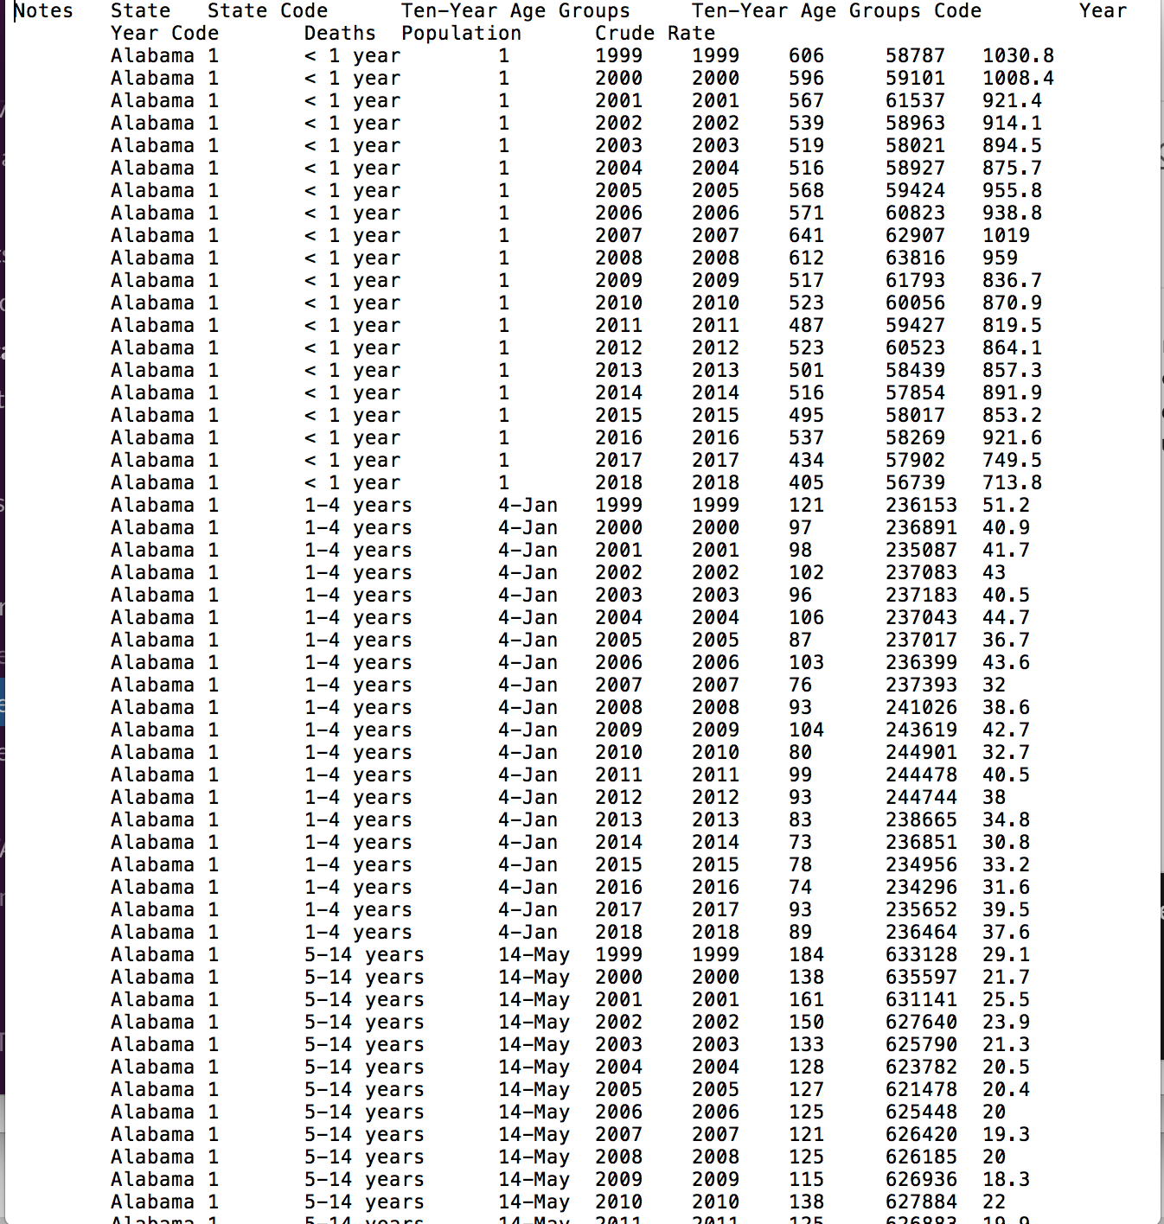
Pre-COVID Data
Source: Mortality for
Obtained Overall death rate (Total Deaths/Total Population)
Broken up by State, Age & Race
Had to merge datasets
Notes:
Gunjuan

Slide 7
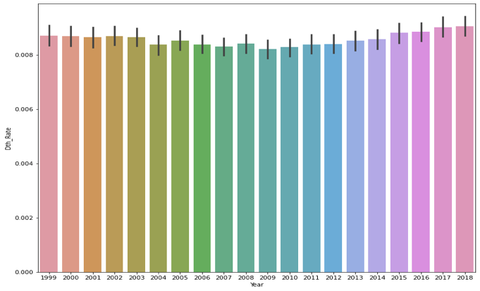
Death Rates Over Last 10 years
Notes:
Gunjan

Slide 8
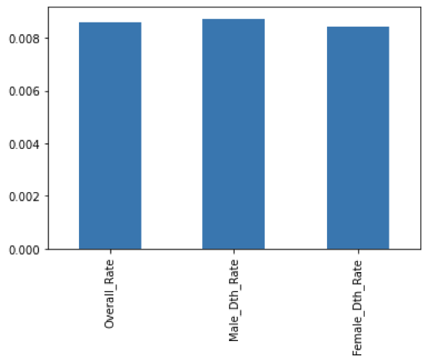
Death Rates by Sex
Notes:
Gunjan

Slide 9
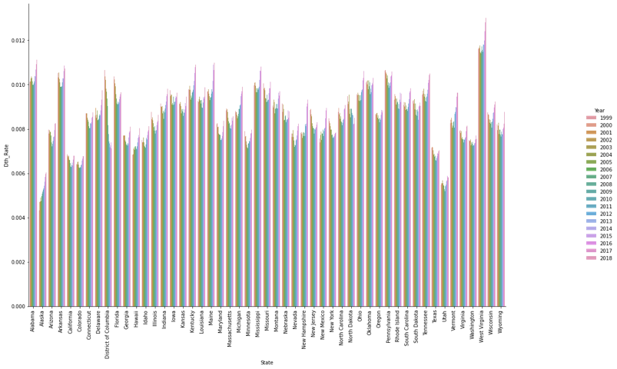
Death Rate by State & Years
Notes:
Gunjan

Slide 10
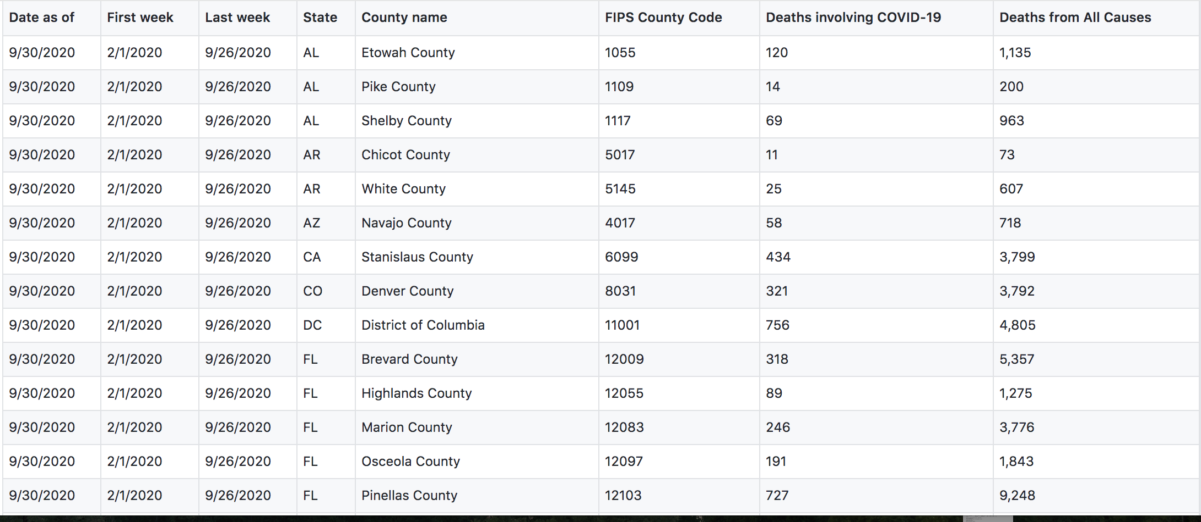
2020 Death Rates Data
Source: CDC COVID deaths in the US
Had to Group By States then add total.
Merge total deaths with total population to get death rate
Notes:
Lorena

Slide 11
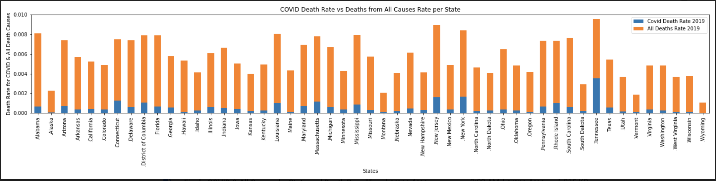
COVID Death Rate per State
Notes:
Lorena

Slide 12
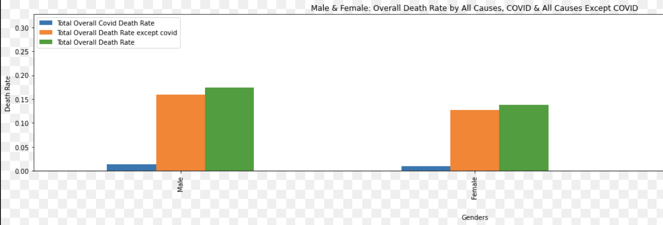
Death Rate by Age
Notes:
Lorena

Slide 13
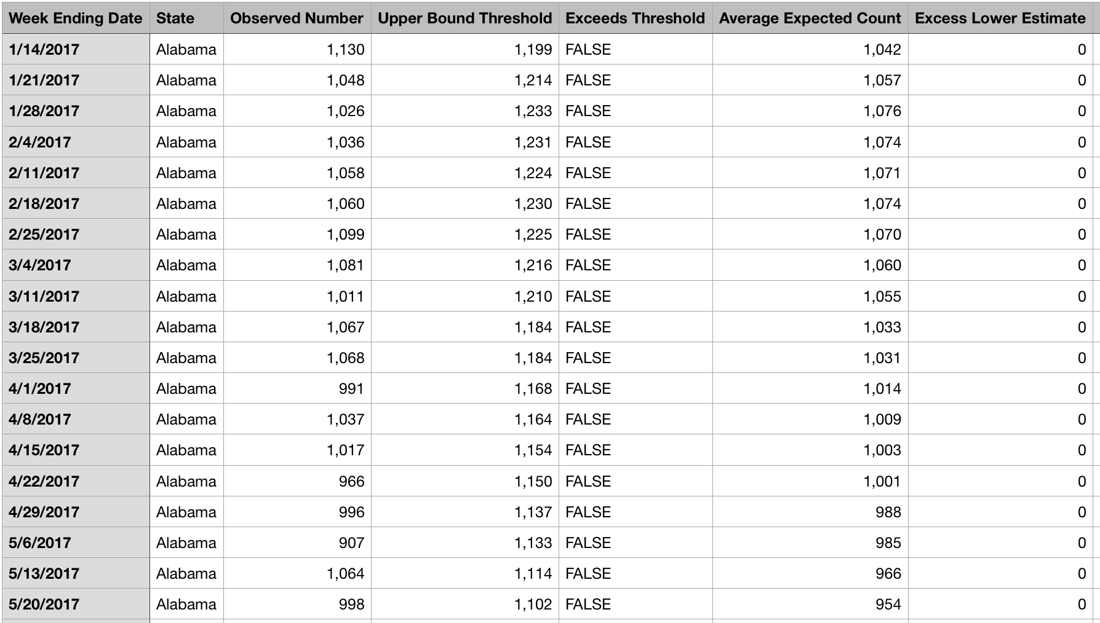
Excess COVID Deaths
Compared expected deaths vs actual deaths from COVID
Did an analysis on which state was affected the most

Slide 14
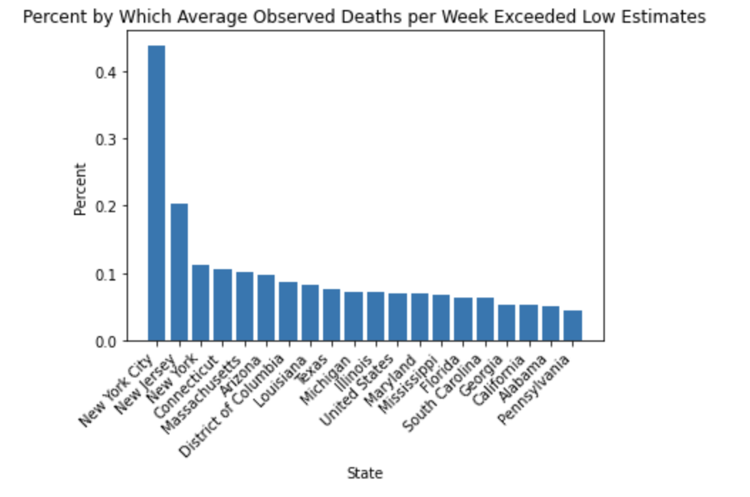
Excess Deaths by States

Slide 15
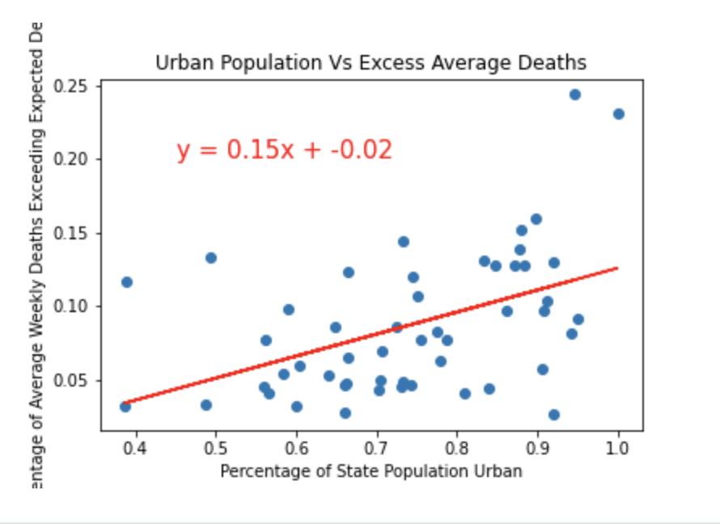
Urban Population vs Excess Deaths

Slide 16
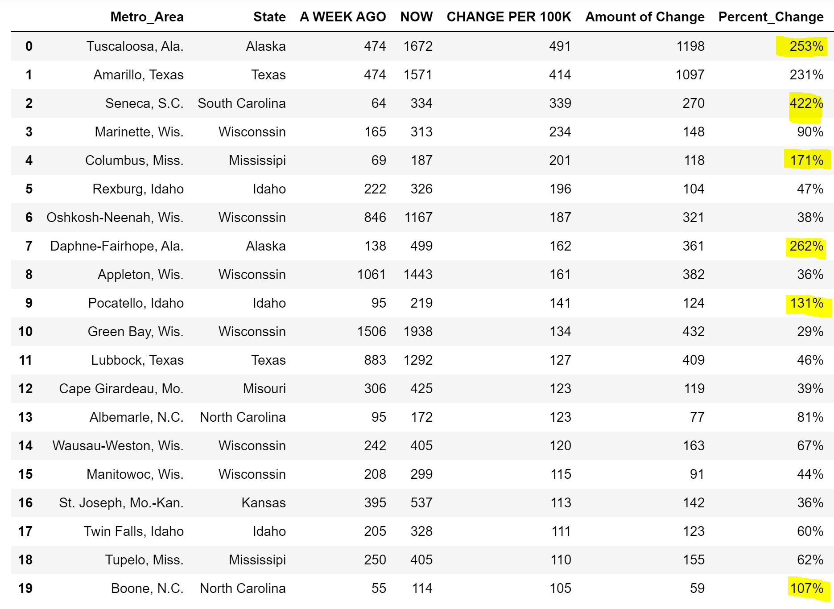
Bad News Ahead …?
New Hot Spots…. Bad News Ahead …?
Notes:
Based on the data, the metro areas above are facing fast rates of infection. For example, Tuscaloosa,Alaska went from 474 infections to 1672 infected in only one week. This shows the rate of predicted infections per 100k at 491. This leads us to a 253 Percent increase.
Seneca South Carolina is facing alarming increases infection rate. From a week ago, they were facing only 64 infected to 334 infections. Although the numbers sound low comparable to others, the rate of infections increased by 422 percent in only a week.

Slide 17
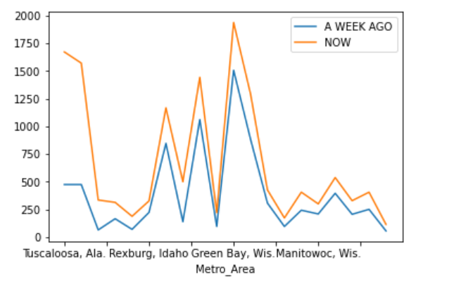
Metro Area: Infection Count Last Week Vs. Now
Notes:
This line graph is a comparison between last weeks infection count rate to this week's infection cout. The orange represents the infection count now comparable today. As you can see, there is a sharp increase in Tuscaloosa Alaska.

Slide 18
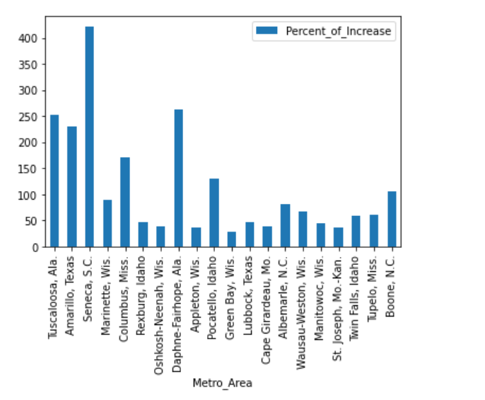
Percent Change per Per Metro Area
Notes:
This is a visual representation

Slide 19
Conclusions
Notes:
Michael

Slide 20
Death Rates are higher with men
COVID Death Rates & Historical death rates are similar among age groups & states
Notes:
Michael

